Slide 1
UBER FARE PREDICTION
Author: Aswathi Sasikumar

Slide 2
Summary
The project is about on world's largest taxi company Uber inc. In this project, we're looking to predict the fare for their future transactional cases. Uber delivers service to lakhs of customers daily. Now it becomes really important to manage their data properly to come up with new business ideas to get best results. Eventually, it becomes really important to estimate the fare prices accurately.

Slide 3
Outline
Business Problem
Data
Methods
Results
Conclusions

Slide 4
Business Problem
This project will help the stakeholder to predict the fare amount for the future transactions.

Slide 5
Data
Uber data set contained 200,000 records
The datset contains the following fields:
key - a unique identifier for each trip
fare_amount - the cost of each trip in usd
pickup_datetime - date and time when the meter was engaged
passenger_count - the number of passengers in the vehicle (driver entered value)
pickup_longitude - the longitude where the meter was engaged
pickup_latitude - the latitude where the meter was engaged
dropoff_longitude - the longitude where the meter was disengaged
dropoff_latitude - the latitude where the meter was disengaged

Slide 6
Methods
Exploratory data analysis was used to analyse the data and to draw conclusions about the fare amount
Invalid data was found in the dataset like fare_Amount<=0,distance >130kms which was practically impossible.
The dataset had lot of outliers and most of the variables were not normally distributed which was challenge in the project.
The data set had only latitudes and longitudes from which distance was calculated.
Dummy variables were created for categorical variables like passenger count,day of the week,month
Log transformations were done to non-normal distributed variables.
After cleaning the data ,Multiple regression using OLS statsmodels was used to develop a model with fare_amount as dependent variable.
Assumptions of Linear Regression:
Linearity
Normality (Residuals)
Homoscedasticity

Slide 7
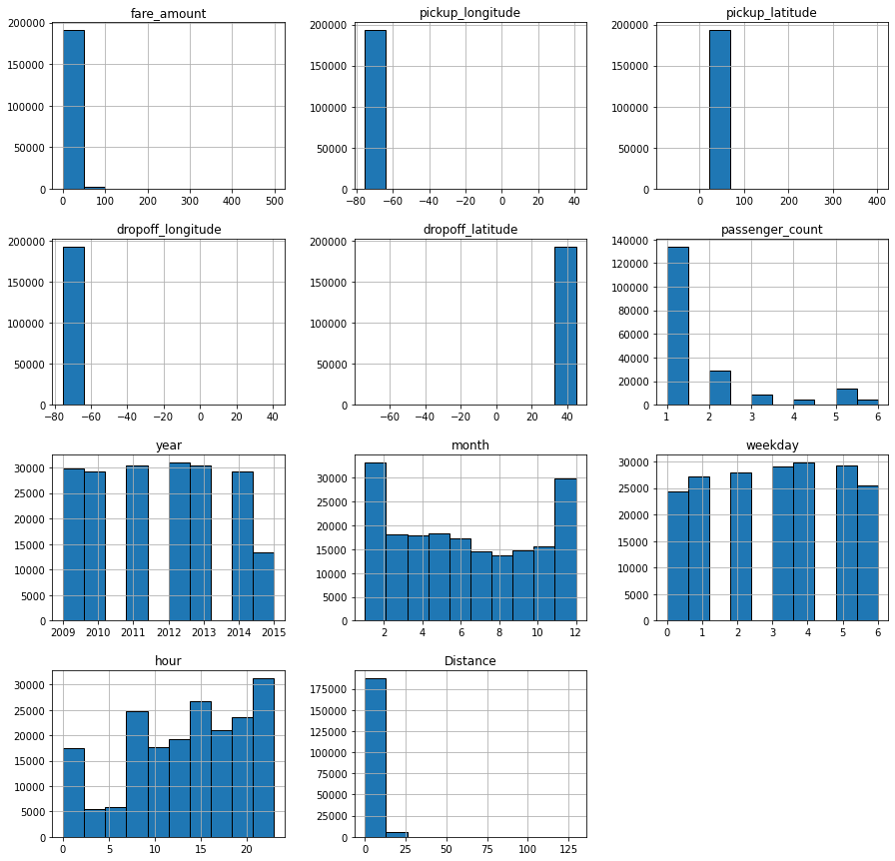
Distribution visualization

Slide 8
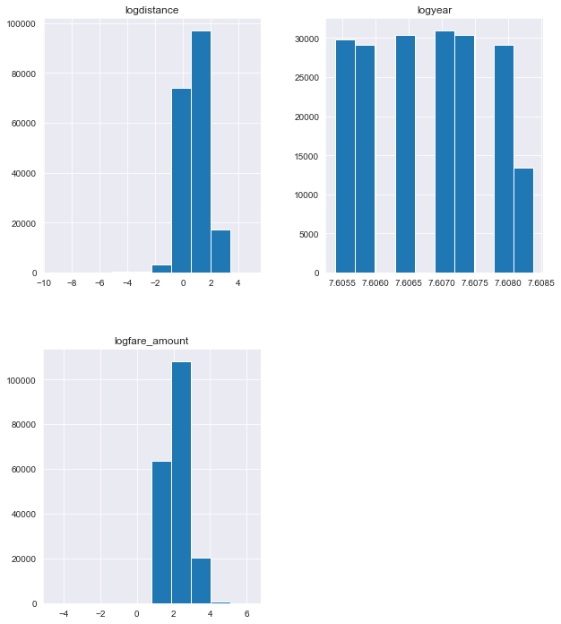
Log transformation

Slide 9
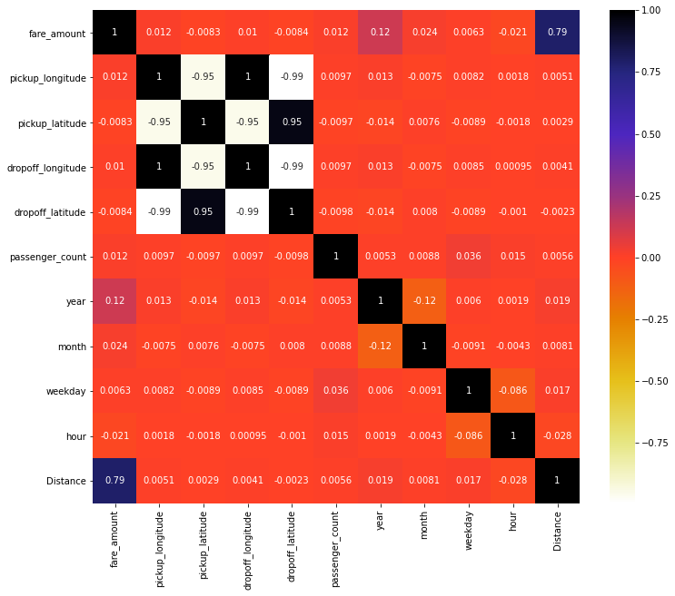

Slide 10
Results
It was found that fare_amount increases with distance which is obvious.It was found that fare_Amount tends to increase during non-peak hours.
Regression models:
Model 1:
Independent variables : all fields
R-squared: 0.614
Normality assumption was not satisfied.
Model 2:
Independent variables : all fields except correlated variables dropoff_latitude', 'dropoff_longitude', 'pickup_latitude'
R-squared: 0.806
Normality assumption was not satisfied.

Slide 11
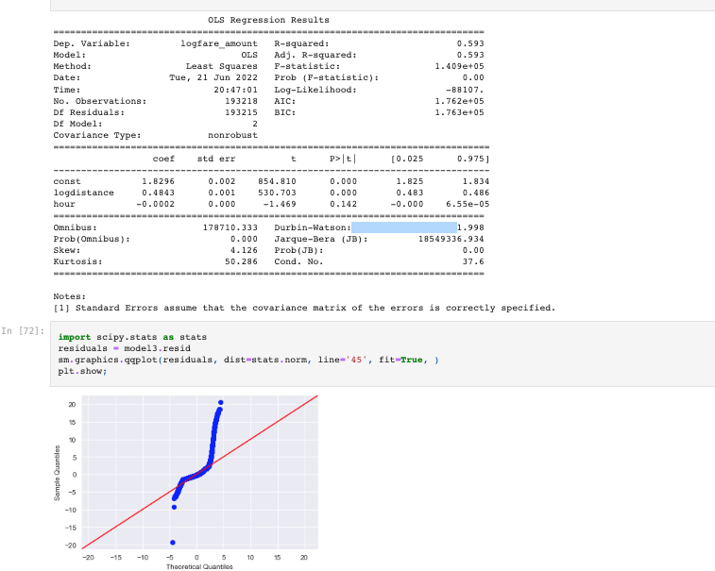
Model 3:Independent variables: distance and hour

Slide 12
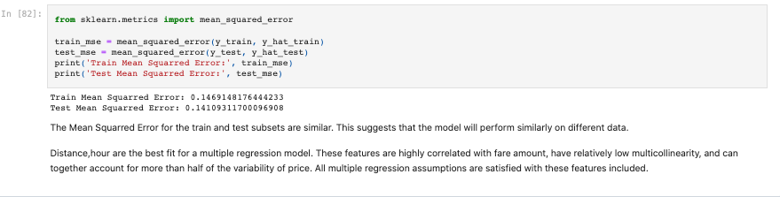
Model validation

Slide 13
Conclusions
It was found that fare_Amount increases with distance which is obvious.It was found that fare_Amount tends to increase during non-peak hours.

Slide 14
Limitations
Modeling the data with other types of regression analysis techniques like logistic regression might give more accurate model.

Slide 15
Thank You!
Email: kukkuaswathi@gmail.com
GitHub: https://github.com/AswathiSasikumar
LinkedIn: https://www.linkedin.com/in/aswathi-sasikumar-21989333/

